Slide 1
How dare the sun rise
Memoirs of a War Child
Written by: Sandra Uwiringiyimana

Slide 2
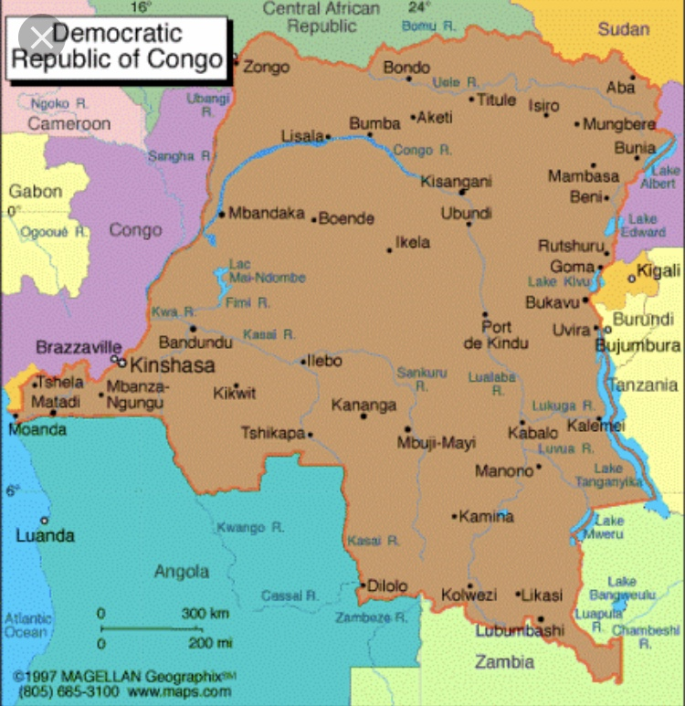
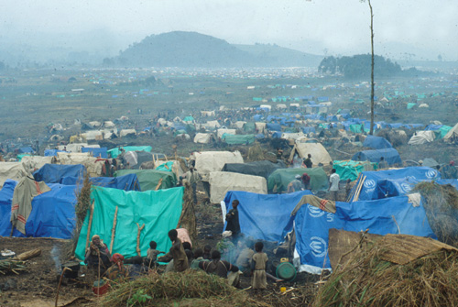
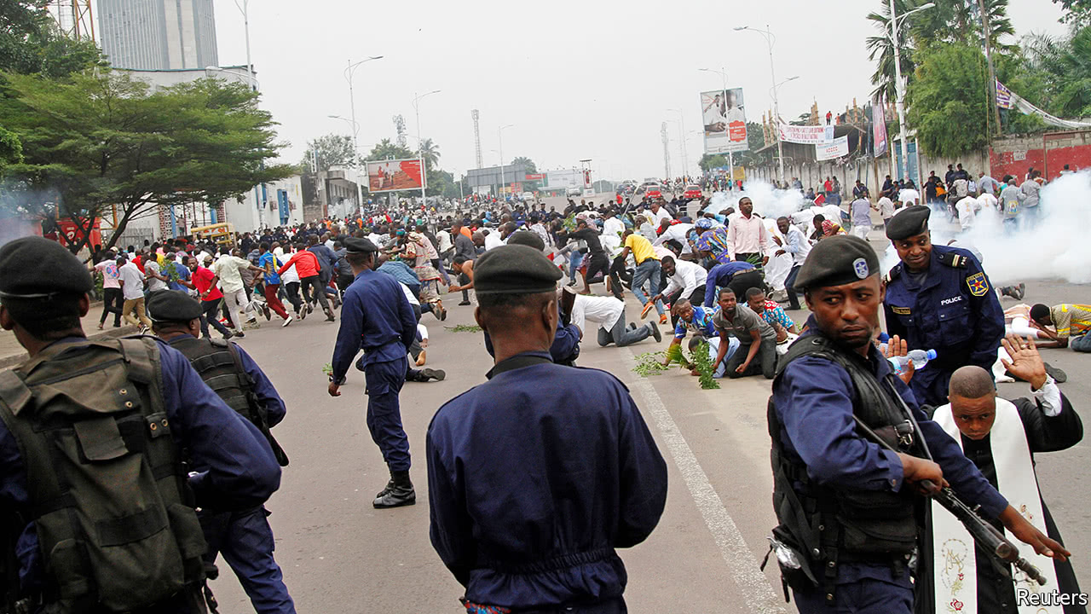
Sandra’s history

Slide 3
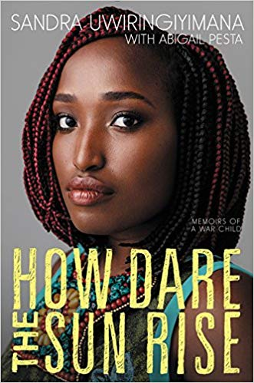
Themes and target audience:
Themes discussed in the novel are:
Advocacy
Community
Cultural differences
Diversity
Family death and family relationships
Identity
Immigration
Trauma
Survivial
war

Slide 4
https://youtu.be/fqgjb6B7Fn0
Sandra uses her voice to inspire her people, and began her path to healing through art and activism

